Slide 1
1500
Attendees
Garry@appXib.com
{X} appXib.com
Notes:
Hosted in Orlando FL the space was SPECTACULAR

Slide 2
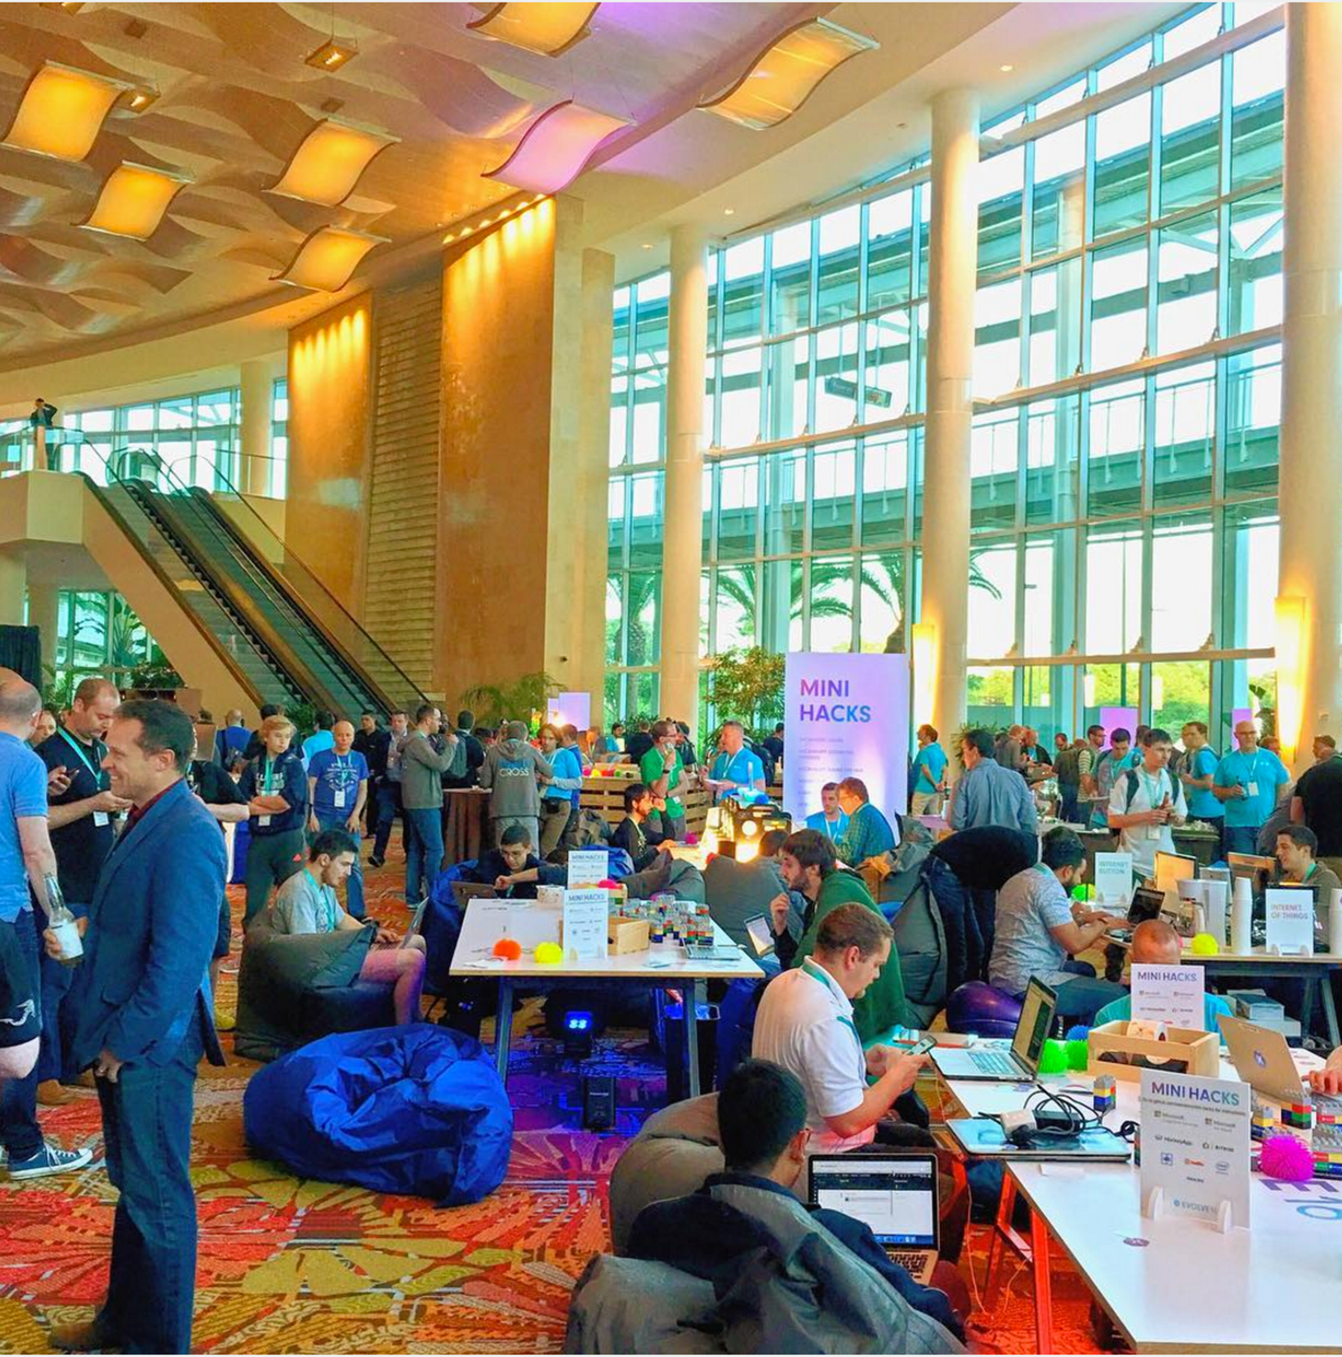
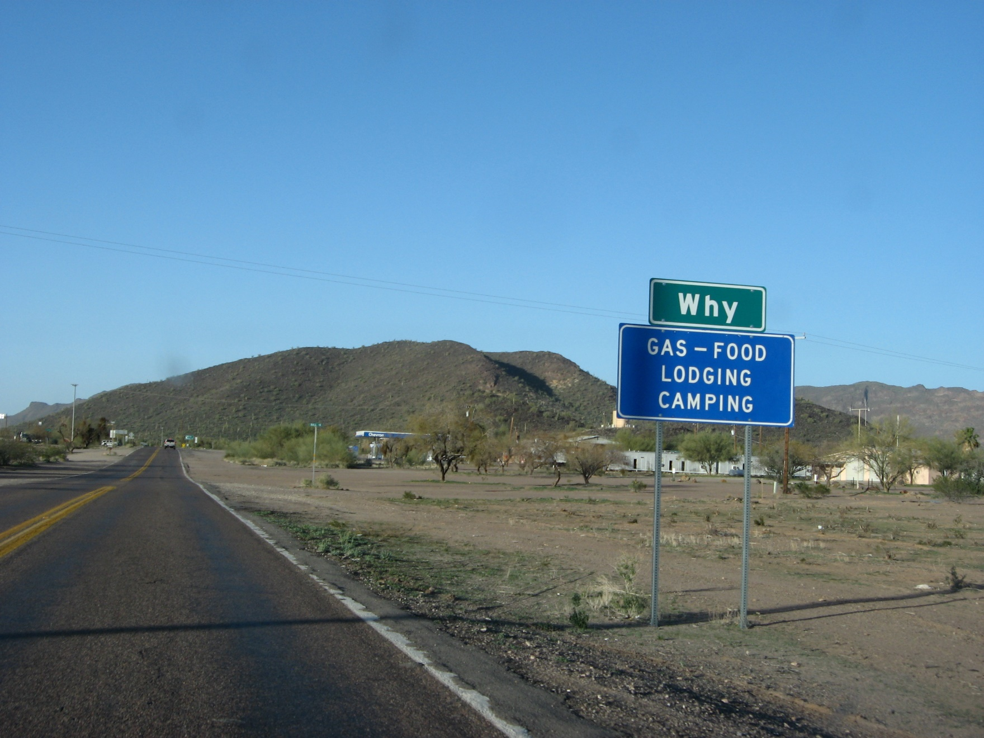

THE
MOBILE
CHALLENGE
Mobile phones are becoming convenience computing devices. That is to say users expect to be able to use them anywhere and have the things they want to do just work.
Garry Whittaker, August 1997
The problem is most apps don’t
Disconnected World
Memory Footprint
Power Usage
Traditionally you have to get this right with separate apps on every platform
Garry@appXib.com
{X} appXib.com
Garry@appXib.com
{X} appXib.com

Slide 3
WHY?
Use Xamarin
Cross Platform Development producing native apps with code reuse
Re-use C# skills. Even use F#
Use familiar tools and packages
No compromise.
Garry@appXib.com
{X} appXib.com

Slide 4
WHY?
We can do anything an Objective C, Swift or Java developer can do, with C#, in Visual Studio, using all the extensions and packages we know and love!
Mike James, Xamarin
Garry@appXib.com
{X} appXib.com
Garry@appXib.com
{X} appXib.com

Slide 5


WHY?
Xamarin +
Microsoft
=Evolving World
2016 Microsoft acquired Xamarin
Completion of acquisition announced at Microsoft’s Build Event by Scott Guthrie with further announcements on pricing.
Further announcements at Xamarin Evolve 2016
Garry@appXib.com
{X} appXib.com

Slide 6
FREE
Xamarin.Android and Xamarin.IOS are now included for free with every edition of Visual Studio 2015
This includes the Free Community Edition
Available as part of Visual Studio Dev Essentials https://www.visualstudio.com/en-us/products/visual-studio-dev-essentials-vs.aspx
Garry@appXib.com
{X} appXib.com

Slide 7

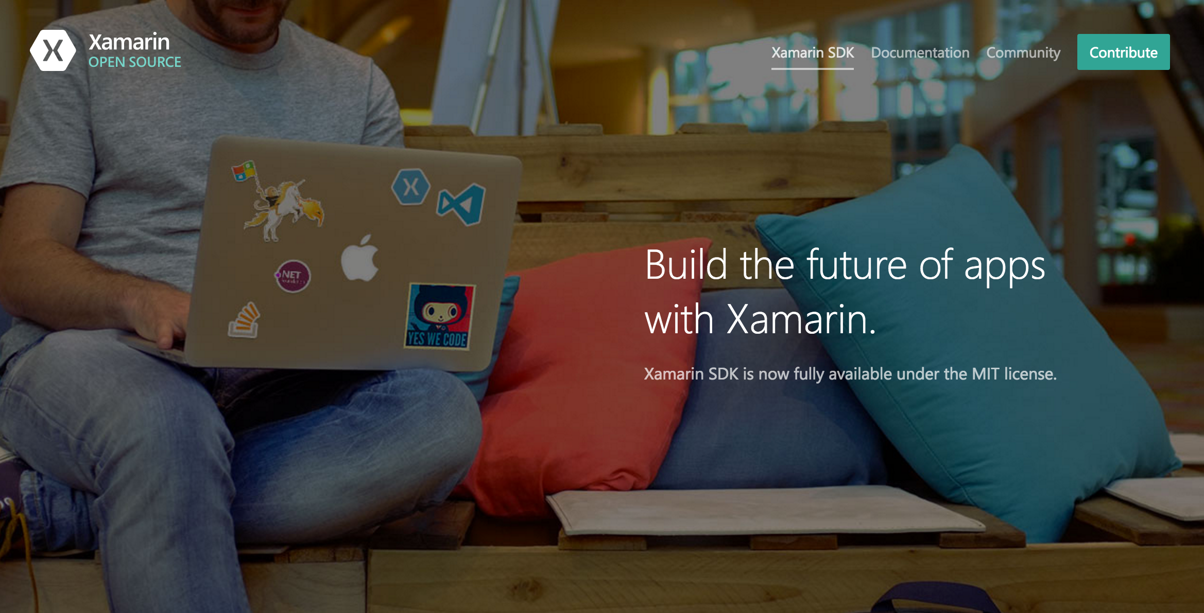
OPEN
At Evolve Xamarin’s founders Nat Friedman and Miguel De Icaza announced the Xamarin SDKs are now:
Open Source under the MIT License
Download today Open.Xamarin.com
Garry@appXib.com
{X} appXib.com

Slide 8

OPEN
Xamarin.Forms
is now also
Open Source under the MIT License
At evolve Jason Smith challenged devs to submit enhancements
FIRST EXTERNAL PULL REQUEST HAS ALREADY BEEN MADE
Download today https://github.com/xamarin/Xamarin.Forms
Garry@appXib.com
{X} appXib.com

Slide 9
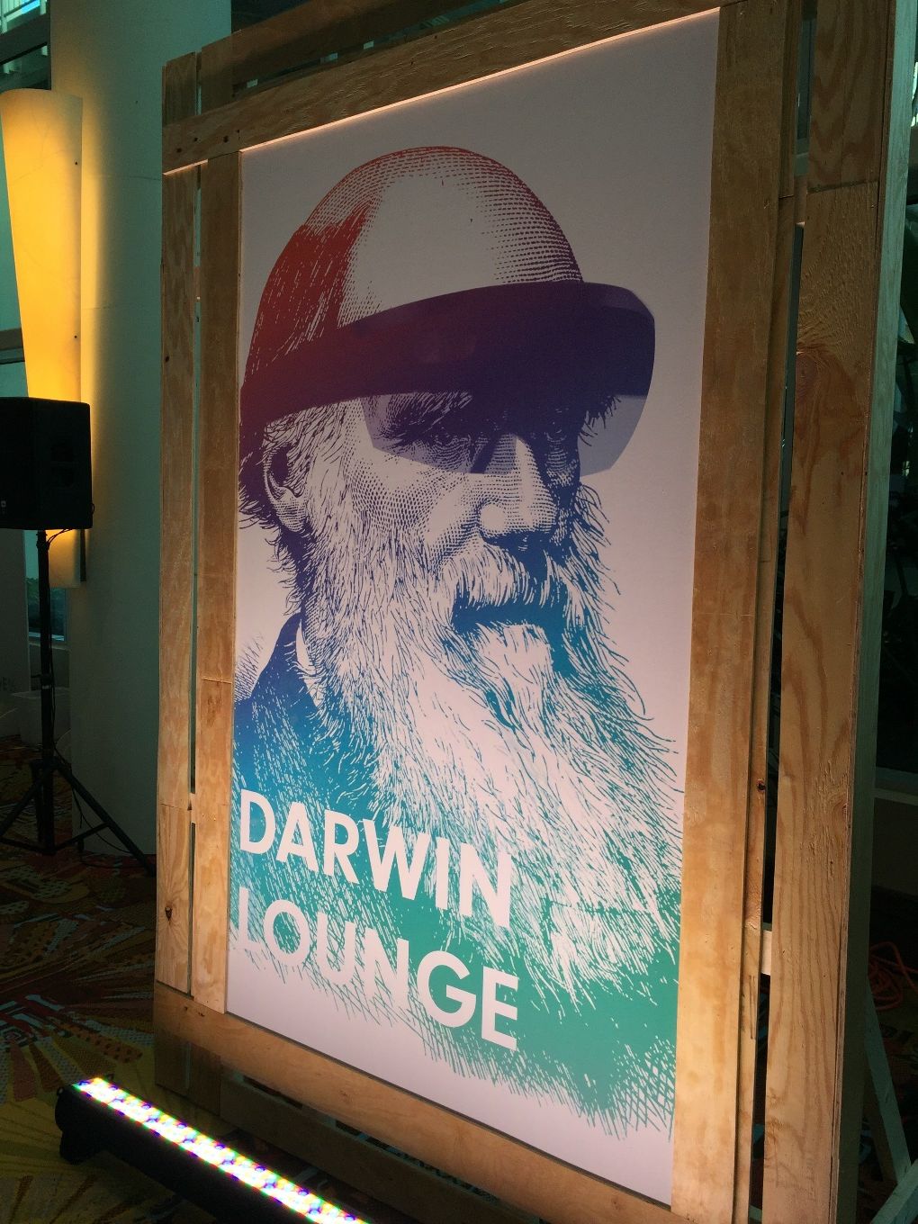
EVOLVING
APP BUSINESS
Xamarin survey of American Corporates
In 2014 corporates were developing 1 or 2 apps mainly for consumer use and app store deployment.
In 2016 the same corporates were developing 100s – mainly LOB – for customers, partners and employees. Often internal deployment.
2016
2014
Garry@appXib.com
{X} appXib.com

Slide 10



Garry Whittaker MVP XMVP XCMD FIAP Director of App Development appXib Ltd Community Lead - Community Connect Project Garry@appXib.com @garryWMA
{X} appXib

Slide 11
Project Details
………………………………………………
•Xamarin.Forms.Pages: Pre-built themable DataPages.
•Xamarin.Forms.Theme.Base: Xamarin.Forms Themes engine.
•Xamarin.Forms.Theme.Light, Xamarin.Forms.Theme.Dark, or your own theme implementation
Note: Because DataPages is currently in preview, you may need to enable “Show pre-release packages” in Xamarin Studio or Visual Studio to install the required NuGets. This should also automatically update your Xamarin.Forms NuGet to 2.3.0-pre
THE EVENT APP
Xamarin.Forms
Xamarin.Forms.DataPages
Xamarin.Forms.Theme
Garry@appXib.com
{X} appXib.com

Slide 12
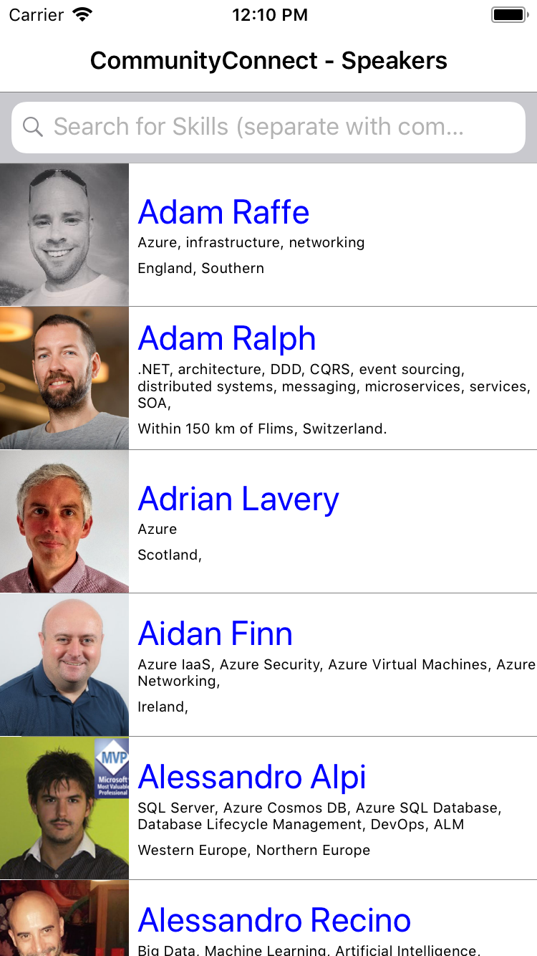
SIGN UP TO
COMMUNITY CONNECT
https://communityconnectportal.azurewebsites.net

Slide 13
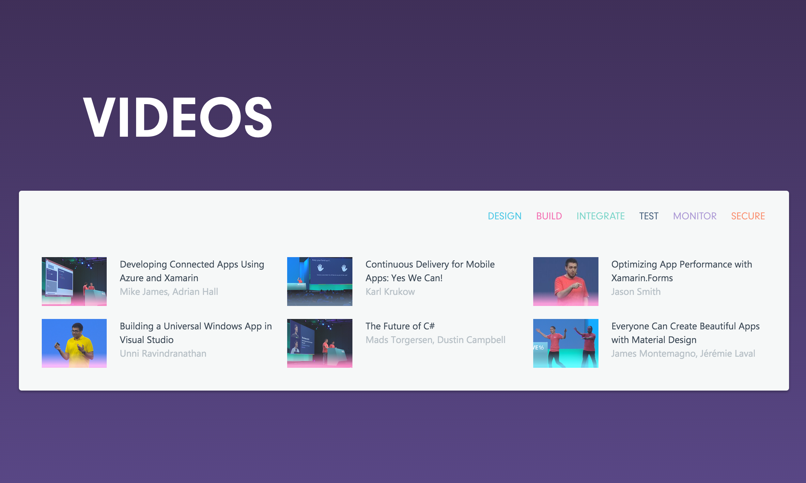
evolve.xamarin.com
RESOURCES

Slide 14
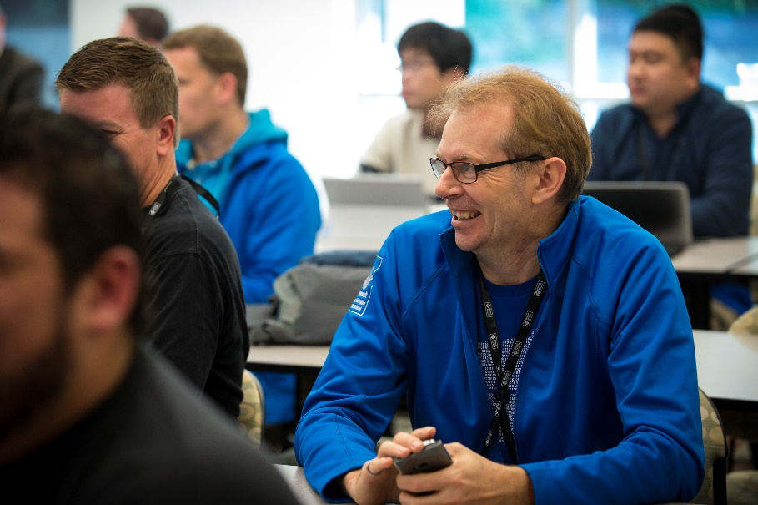
CONTACT ME
Garry Whittaker MVP, XCMD, FIAP
Director of App Development
www.appXib.com
Occasional Blog:
http://www.conveniencecomputing.com
Email: garry@appxib.com
Twitter: @garrywma
USEFUL RESOURCES:
www.xamarin.com/blog
University.xamarin.com
http://motzcod.es/ - James Montemagno’s blog

Slide 15
THANKS
FOR VIEWING
Garry@appXib.com
{X} appXib.com

